Slide 1
Place-Based Public Art
Name
Institution
Course
Instructor
Date

Slide 2
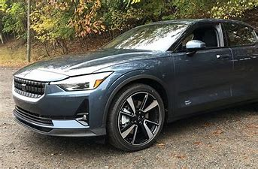
The Future of Place-based Public Art
Bipolar future
Public art will characterize luxurious commodities
People will testify about the under-financed and inadequate government policy

Slide 3

How art can help our communities heal
Art therapy
Worldwide connection of people

Slide 4

How Art can Uplift the Voices of Minority Communities
Engagement among the inhabitants through;
Charitable work,
Volunteering, and
Voting

Slide 5
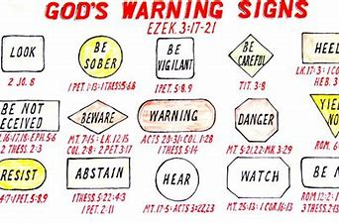
How art can tell stories that need to be told
Representation of legendary myths
Cautioning people about religious issues
Cautioning people about historical issues

Slide 6

Conclusion
Public art;
Allows people to connect
Helps in communication of predicaments among minority communities

Slide 7
References
Baines, G., Farber, L., Hill, S., Jethro, D., Rankin, E., Roux, N., ... & Younge, G. (2017). Public art in South Africa: Bronze Warriors and plastic presidents. Indiana University Press.
Radice, M. (2018). Putting the public in public art: An ethnographic approach to two temporary art installations. City & Society, 30(1), 45-67.
Redaelli, E. (2018). Creative placemaking and theories of art: Analyzing a place-based NEA policy in Portland, OR. Cities, 72(Part B), 403-410.

